Slide 1
Journal
Make sure to clearly date your entry, and answer the following questions:
How are political borders decided upon?
Why is the world divided into countries?
Is this division a good thing or a bad thing? Why?
Remember, journals are not about the “right” answers, but the thoughtful ones.

Slide 2
Chapter 1-Understandings of Nation and Nationalism
Social 20-1

Slide 3
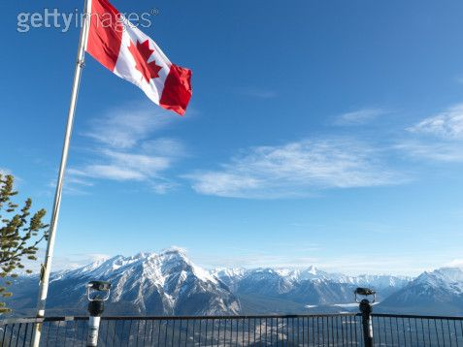
Key Issue
To what extent should nation be the foundation of identity?

Slide 4
To what extent do understandings of nation and nationalism vary?
Questions for Inquiry:
What is a nation?
What is nationalism?

Slide 5
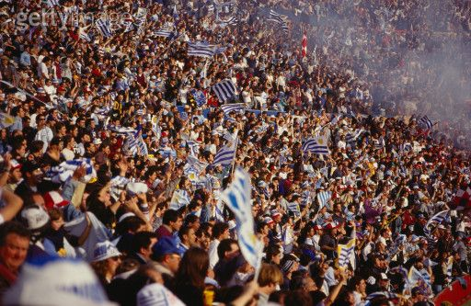
QI: What is a nation?
How would you answer this question?
It can be defined as a group of people who feel connections to one another in some way.
What might cause people to “feel” like a nation?

Slide 6
QI: What is a nation?
A nation can be viewed as something found in the feelings and minds of people, and internal connection to others.
“Shared experiences”
  Ethnic background
  Cultural values/beliefs
  History
  Language
  Spirituality
  Geography
  Politics and citizenship

Slide 7
QI: What is a nation?
Nations develop when people internalize the feelings of shared experience and belonging.
People may belong to multiple nations.
See Figure 1-4 in your text.

Slide 8
Exploring Understandings of Nation
geography
Ethnic background
and ancestry
history
Nation
Religion and
spirituality
Cultural values
and beliefs
Politics and
citizenship
Language and
communication
Notes:
Pages 12-14 descriptions of nation

Slide 9
Nation and Nation-state
Nation-state- a territory within internationally recognized boundaries and a politically organized body of people under a sovereign government
They are often referred to as “countries”, and many nations may reside within them.
There are more than 190 nation-states in the world.

Slide 10
Nation and Nation-state
People in a nation-state may or may not share cultural or linguistic connections.
They live in a politically defined territory that operates with common legal and moral beliefs.
Canada is a nation-state, but some argue it is not a nation.
What do we share as Canadians?
Notes:
Show the Rant- is this accurate to what you believe it means to be Canadian?

Slide 11
Nation and Nation-state
What we do share as a nation-state:
  A belief in democratic government
  The protection of rights and freedoms as described in our Charter
  A belief in the principles of a mixed economy

Slide 12
Nation and Nation-state
How can people’s different understandings of nation lead to conflict?
Read pages 16-17 independently, then discuss questions 1-3 on page 17 with a partner. Be prepared to share your discussion.

Slide 13
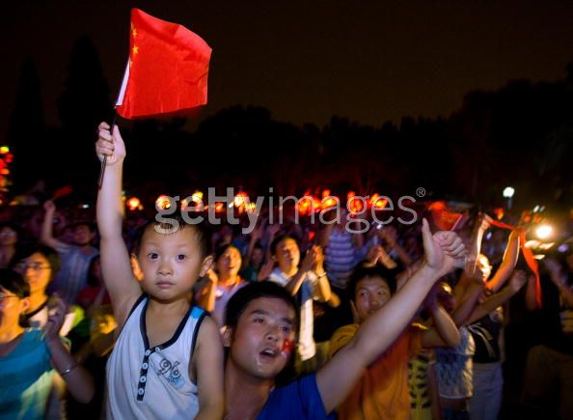
QI: What is nationalism?
Nationalism is the collective, shared sense of belonging of people who identify themselves as a nation.

Slide 14
Creating a sense of Nationalism
Geography and Nationalism
We often ask someone “Where are you from?” when we first meet them. Why?
Canada’s First Nations often derive their identity and sense of nationalism from the land
Quotation on page 21
Can you think of natural and manmade features of the land that contribute to a nation’s identity?
Can you feel connection to a place even if you don’t live there?

Slide 15
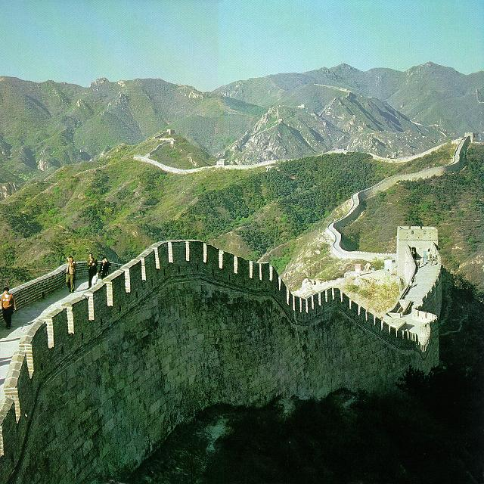
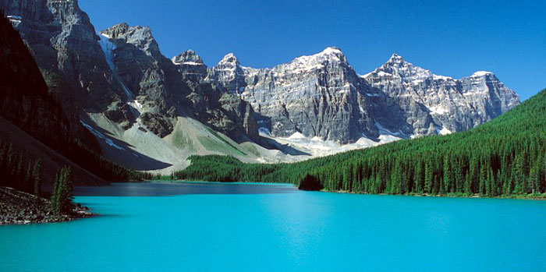
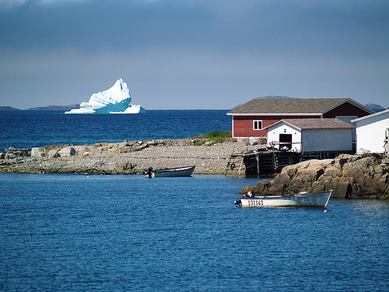
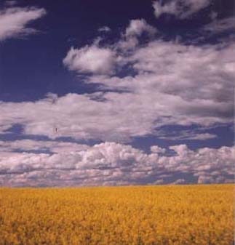
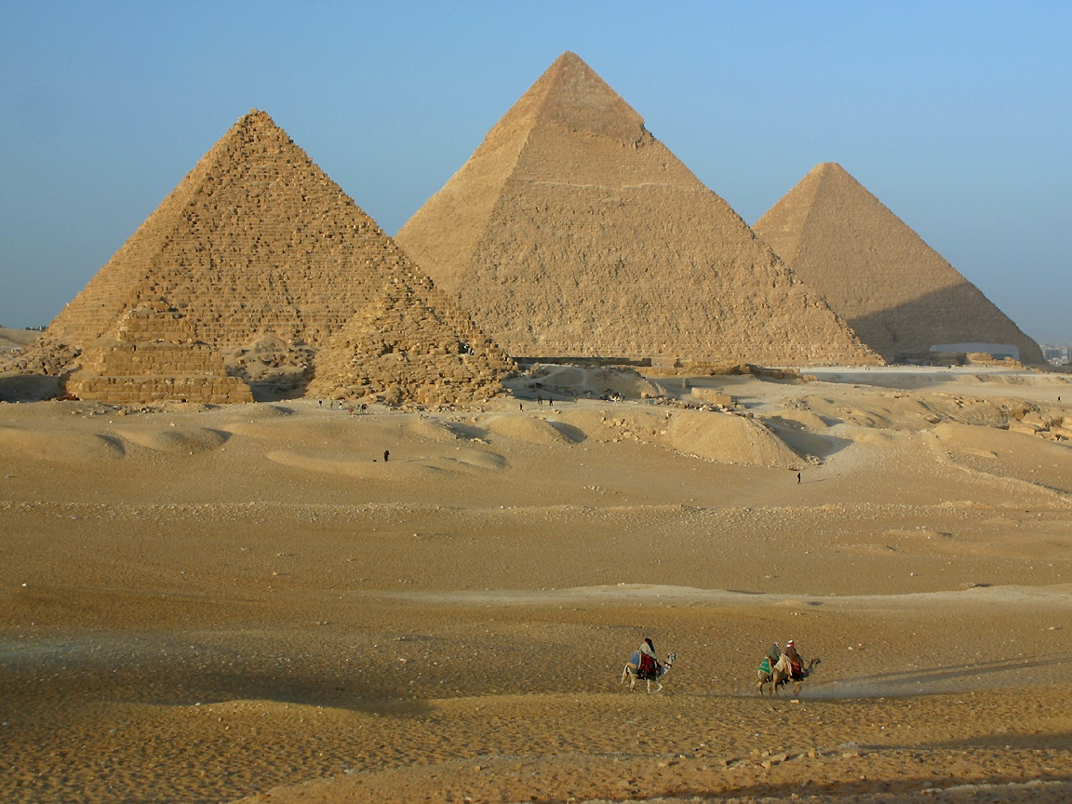

Slide 16
Creating a sense of Nationalism
Language and Nationalism
Common communication is needed to share ideas, knowledge and wisdom
Some say that when a language dies, so does the culture or nation
“I Lost My Talk” Page 23

Slide 17
Creating a sense of Nationalism
Spirituality, Religion and Nationalism
Spirituality is complex and can centre on finding the meaning of life, connecting with a spiritual being or achieving individual potential
From Aboriginal perspectives, spiritual beliefs come from connection to the natural world

Slide 18
Creating a sense of Nationalism
Ethnic Ties and Nationalism
Nationalism can develop from shared history or shared pride and loyalty
Because of growing migration, most nation-states have many nations within their borders

Slide 19
Creating a sense of Nationalism
Culture and Nationalism
Culture is an unwritten way of knowing, being, and acting among the people of a nation based on shared traditions, beliefs and values
What are some of the aspects of culture?
Clothing, music, food, arts, ways of life, traditions, stories

Slide 20
Creating a sense of Nationalism
Citizenship and Nationalism
Citizenship- the membership and participation of individuals in a political community, most times a nation-state
It is a tangible, legal indication of belonging
What are some ways we participate as citizens?
Why is it important to legally be a citizen in addition to feeling a sense of nationalism?

Slide 21
Creating a sense of Nationalism
Nationalism is often confused with patriotism
Patriotism is love for a nation or nation-state, and relates to pride in that nation’s culture and achievements
Usually expressed though symbols such as flags and monuments
Can sometimes involve putting the nation’s interests above those of the individual

